Slide 1




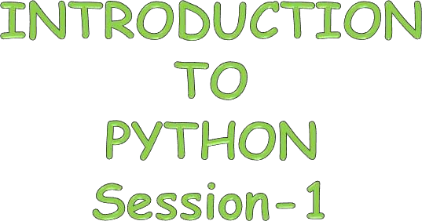

~Animesh

Slide 2

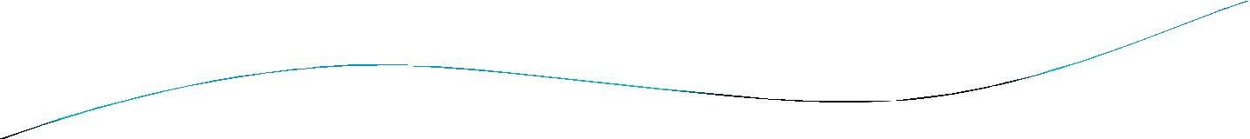
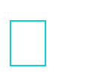
Agenda
What is Python…?
Differences between program and scripting language History of Python
Installing Python IDE
Who uses python today What can I do with python
A Sample Code Python code execution Basic Concepts

Slide 3

What is Python…?
Python is a general purpose programming language that is often applied in scripting roles.
Python is also called as Interpreted language

Slide 4

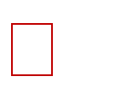
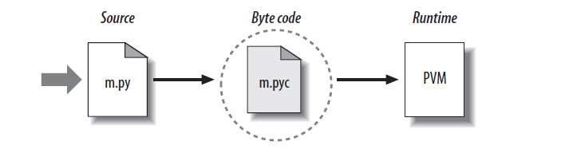
Python Code Execution
Python’s traditional runtime execution model: source code you type is translated to byte code, which is then run by the Python Virtual Machine. Your code is automatically compiled, but then it is interpreted.
Source code extension is .py
Byte code extension is .pyc (compiled python code)

Slide 5
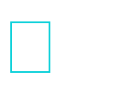
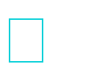
Differences between program and scripting language
Program
a program is executed (i.e. the source is first compiled, and the result of that compilation is expected)
A "program" in general, is a sequence of instructions written so that a computer can perform certain task.
Scripting
a script is interpreted
A "script" is code written in a scripting language. A scripting language is nothing but a type of programming language in which we can write code to control
another software application.

Slide 6

Why was python created?
"My original motivation for creating Python was the perceived need for a higher level language in the Amoeba [Operating Systems] project.
I realized that the development of system
administration utilities in C was taking too
long. shell
Moreover, doing these things in the Bourne
wouldn't work for a variety of reasons. ...
So, there was a need for a language that would bridge the gap between C and the shell”
- Guido Van Rossum

Slide 7
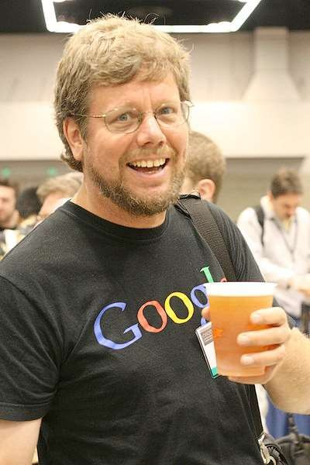
Python: Benevolent Dictator For Life
“Python is an experiment in how much freedom program-mers need. Too much freedom and nobody can read another's code; too little and expressive-ness is endangered.”
- Guido van Rossum

Slide 8

Scope of Python
Science
- Bioinformatics System Administration
-Unix
-Web logic
-Web sphere
Web Application Development
-CGI
-Jython – Servlets Testing scripts

Slide 9

Why to use Python…?
The following primary factors cited by Python users seem to be these:
Python is object-oriented
Structure supports such concepts as polymorphism, operation overloading, and multiple inheritance.
Indentation
Indentation is one of the greatest feature in Python. It's free (open source)
Downloading and installing Python is free and easy Source code is easily accessible

Slide 10

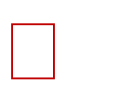
It's powerful
Dynamic typing
Built-in types and tools
Library utilities
Third party utilities (e.g. Numeric, NumPy, SciPy)
Automatic memory management It's portable
Python runs virtually every major platform used today
As long as you have a compatible Python interpreter installed, Python programs will run in exactly the same manner, irrespective of platform.

Slide 11



It's mixable
Python can be linked to components written in other languages easily
Linking to fast, compiled code is useful to computationally intensive
problems
- Python/C integration is quite common
It's easy to use
No intermediate compile and link steps as in C/ C++
Python programs are compiled automatically to an intermediate form called bytecode, which the interpreter then reads
This gives Python the development speed of an interpreter without
the performance loss inherent in purely interpreted languages
It's easy to learn
Structure and syntax are pretty intuitive and easy to grasp

Slide 12

Enough to understand the code
Indentation matters to code meaning
Block structure indicated by indentation First assignment to a variable creates it
Variable types don’t need to be declared.
Python figures out the variable types on its own. Assignment is = and comparison is ==
For numbers + - * / % are as expected
Special use of + for string concatenation and % for string formatting (as in C’s printf)
Logical operators are words (and, or, not) not symbols The basic printing command is print

Slide 13


Installing Python
Python is pre-installed on most Unix systems, including Linux and MAC OS X
But for in Windows Operating Systems , user can download from the https://www.python.org/downloads/
- from the above link download latest version of python IDE and install, recent version is 3.4.1 but most of them uses version 2.7.7 only

Slide 14

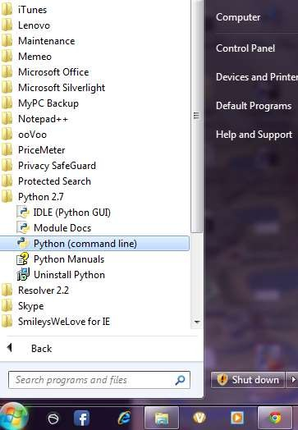
After installing the Python Ver#2.7.7, go to start menu then click on python 2.7 in that one you can select python (command line) it is prompt with >>>

Slide 15

‘Hello World
Hello World : the ages old tradition !
print(‘Hello World’)
x=‘Hello’
print(x+ ‘World’)
# String concat.
http://jupyter.org/try #online IDE
https://ide.geeksforgeeks.org/
Learnpython.org #for practice

Slide 16
‘Hello World
Data Types:
Python is completely object oriented, and not "statically typed". You do not need to declare variables before using them, or declare their type. Every variable in Python is an object.
myfloat = 7.0
print(myfloat)
myfloat = float(7)
print(myfloat)
O/P— 7.0
7.0

Slide 17
‘Hello World
Lists:
Lists are very similar to arrays. They can contain any type of variable, and they can contain as many variables as you wish. It could be iterated easily.
mylist = []
mylist.append(1)
mylist.append(2)
mylist.append(3)
print(mylist[0]) # prints 1
print(mylist[1]) # prints 2
print(mylist[2]) # prints 3
# prints out 1,2,3
for x in mylist:
print(x)
--Lists are mutable
mutable -- that can be changed
--Series of value defined in Square brackets []
--Lists are iterable

Slide 18
‘Hello World
Tuples:
--Group of values like lists defined using() are tuples
--Tuples are immutable
--Tuples are great for integrity when immutability is required
tup=(1,'two',3,'four')
tup[3]=5
Error -----------
TypeError Traceback (most recent call last)
<ipython-input-51-247e64807791> in <module>()
----> 1 tup=(1,'two',3,'four'); tup[3]=5
TypeError: 'tuple' object does not support item assignment

Slide 19
‘Hello World
Examples (Lists):
s='Bangalore';
p=list(s);
p[0]= 'M';
s=''.join(p);
print(s);
O/P -- Mangalore
s='Bangalore';
p=list(s);
p[0]= 'M';
s=' '.join(p);
print(s);
O/P -- M a n g a l o r e
list3 =[5,6,'Ram',7,8];
list4= [9,10];
print (list3 + list4)
O/P --[5, 6, 'Ram', 7, 8, 9, 10]
x=(list3 + list4);
print(len (x));
O/P -- 7
------------
(list3 + list4)[5]
O/P -- 9

Slide 20
‘Hello World
Sets:
s1={1,2,3,4,'red','blue'};
s2={3,4,'blue'};
print(s1.union(s2));
print(s1.intersection(s2));
O/P --
{1, 2, 3, 4, 'blue', 'red'}
{3, 4, 'blue'}
---------------------------
q1=[1,2,2,2,2,2,33,44,5];
set_new=set(q1);
print(set_new)
O/P -- {1, 2, 33, 5, 44}
----------------------------
v1=set();
v1.add(91);
v1.add(21);
v1.add(908);
print(v1);
O/P -- {91, 908, 21}
-----------------------------
v1.remove(908);
print(v1);
O/P -- {91, 21}

Slide 21
‘Hello World
String Functions:
fname=‘Vikash’
print(f_name.lower())
print(f_name.upper())
print(f_name.capitalize())
----Outputs
vikash
VIKASH
Vikash
--------------------------------------------
print('123'.isnumeric()) --- True
print('123a'.isnumeric()) --- False

Slide 22
‘Hello World
Basic Operators:
number = 1 + 2 * 3 / 4.0
print(number)
O./P-- 2.5
# Try these
remainder = 11 % 3
print(remainder)
squared = 7 ** 2
cubed = 2 ** 3
print(squared)
print(cubed)

Slide 23
‘Hello World
String formatting:
name = "John"
age = 23
print("%s is %d years old." % (name, age))
Here are some basic argument specifiers you should know:
%s - String (or any object with a string representation, like numbers)
%d - Integers
%f - Floating point numbers
%.<number of digits>f - Floating point numbers with a fixed amount of digits to the right of the dot.
%x/%X - Integers in hex representation (lowercase/uppercase)

Slide 24
‘Hello World
Exercise:
Q. Write a code to print the following statement by using the values in the tupple:
Expected Output : Hello John Doe your age is 53.44
data = ("John", "Doe", 53.44)

Slide 25
‘Hello World
Solution:
data = ("John", "Doe", 53.44)
format_string = "Hello %s %s. Your age is %d.“
print(format_string % data)
https://www.learnpython.org/en/Basic_String_Operations

Slide 26
‘Hello World
Conditions(If/Else):
x = 2
if x == 2:
print("x equals two!")
else:
print("x does not equal to two.")
Exercise:
https://www.learnpython.org/en/Conditions

Slide 27
‘Hello World
Loops:
For Loop:
cities = ['Patna','Bangalore','Delhi','Kolkata']
for city in cities:
print(city)
While Loop:
count = 0
while count < 5:
print(count)
count += 1

Slide 28
‘Hello World
Exercise:
Q. Print all the odd numbers between 1 to 100 which are divisible by 3.

Slide 29
‘Hello World
Dictionaries:
Groups of keys and values defined using {}
key and value separated by :
Keys must be immutable
kv1={'A':'apple','B':'Bat','C': 'Cat'}
print(kv1.keys())
dict_keys(['A', 'B', 'C'])
print(kv1.values())
for k,v in kv1.items():
print(k)
print(v)

Slide 30
‘Hello World
Dictionaries:
kv2={'M':'Mahendra','S':'Singh','D': 'Dhoni'}
kv2['C']='CSK'
for k,v in kv2.items():
print('{0} for {1}'.format (k,v))
O/P:
M for Mahendra
S for Singh
D for Dhoni
C for CSK

Slide 31
‘Hello World
Functions:
Function def followed by the name of the function
body of the function starts with ---- a:
and it is indented
----------------------------------------
def sayhello(name):
print("Hello "+name)
O/P -
Hello Vikash
Calling -- sayhello('Vikash')
----------------------------------------
-->First Class Functions
Functions are variable
we can retain it
pass function as parameters
def sayhello(name):
print("Hello "+name)
O/P -
Hello Vikash

Slide 32
‘Hello World
Functions:
Inner function :
Function inside the function
---------------------------------------------
def sayhi(name):
print('Hi', name)
def getaddress(name1):
print('Hey', name1 , '! where are u from ?')
getaddress(name)
sayhi('Suresh')
O/P-
Hi Suresh
Hey Suresh ! where are u from ?
def sayhi(name):
print('Hi', name)
def getaddress(name1):
print('Hey', name1 , '! where are u from ?')
getaddress(name)
sayhi('Suresh')

Slide 33
‘Hello World
Functions:
Higher Order function :
Functions as parameter
def hi():
return "I say Hi!"
def hello():
return "I say HELLO!"
def greeting(fn):
#storing the function in a variable
greet=fn()
print(greet)
greeting(hi)
greeting(hello)
O/P-
I say Hi!
I say HELLO!

Slide 34
‘Hello World
List Comprehension:
List Comprehension
Elegant way to define and create list in Python
lst=[x**2 for x in range (1,5)]
lst-> [1,4,9,16]
--------- Examples ------------
lst=[x**2 for x in range (1,5)]
print(lst)
O/P:
[1, 4, 9, 16]
Try these:
Celsius=range(0,50)
Fahrenheit=[((float(9)/5)*x+32) for x in Celsius]
print(Fahrenheit)
--------------
[x for x in range (1,20,2)]
O/P-
[1, 3, 5, 7, 9, 11, 13, 15, 17, 19]
-----------------
[x for x in range (1,20) if x%2 ==1]
O/P-
[1, 3, 5, 7, 9, 11, 13, 15, 17, 19]

Slide 35
Scope (variable):
i=1
def A():
i=5
print('I am the local i= ',i)
print('I am the global i= ',i)
A()
O/P-
I am the global i= 1
I am the local i= 5

Slide 36
Scope (variable):
LEGB
Local -- can be inside a function or class method
Enclosed -- can be its enclosing fn , e.g if a fn is wrapped in another fn
Global-- -- refers to the uppermost level of the executing script
Built in -- special name python reserves for itself

Slide 37
Scope (variable):
----------------Examples-----------
a_var='global value'
def outer():
a_var='enclosed value'
def inner():
a_var='local_value'
print(a_var)
inner()
outer()
O/P--
local_value
a_var='global value'
def outer():
a_var='enclosed value'
def inner():
# a_var='local_value'
print(a_var)
inner()
outer()
O/P--
enclosed value

Slide 38
Scope (variable):
----------------Examples-----------
a_var='global value'
def outer():
#a_var='enclosed value'
def inner():
# a_var='local_value'
print(a_var)
inner()
outer()
O/P-
global value

Slide 39
Scope (variable):
Nonlocal variable:
Assigns the variable as Outer but non global variable
(Only one level up)
i=1
def A():
i=5
print('I am the local i=',i)
def B():
nonlocal i
print('I am the nonlocal i =',i)
i=6
print('I am the new i =',i)
B()
print('I am the global i =',i)
A()
Output:
I am the global i = 1
I am the local i= 5
I am the nonlocal i = 5
I am the new i = 6

